Slide 1
RCLLD User Guide

Slide 2
You will have been sent a link by the RCLLD coordinator
This link is the initial stage application called Expression of Interest (EOI)
Complete all the details – you can save as draft and return to it if required (if you lose your link, please contact the coordinator who can resend to you)
When you are happy that all information is complete, then press Submit and it will be sent to the coordinator to review
If there are any issues with the information, then it can be returned to you by the coordinator for additional details to be added
If you do not meet the criteria, then you will receive an email advising of this
If the coordinator is happy with the EOI, then it will be approved and a full application emailed to you

Slide 3
Click the link in the email that you will receive to complete the full application. The information that was provided as part of the EOI will still be there and won’t require to be completed again
When you are happy that all information is complete, then press Submit and it will be sent to the coordinator to review
If there are any issues with the information, then it can be returned to you by the coordinator for additional details to be added
If you do not meet the criteria, then you will receive an email advising of this
If the coordinator is happy with the application, then it will be passed to the Local Action Group for full approval

Slide 4
Each application will be reviewed by the LAG
If there are any issues with the information, then your application will be returned to you by the coordinator for additional details to be added
If you do not meet the approval criteria, then you will receive an email advising of this
If the LAG are happy with the application, then it will be approved, with any additional conditions that are unique to your application, and a formal offer letter will be sent.
The offer of grant letter will come via an email and is a fully UK and Scottish government approved e-sign process

Slide 5
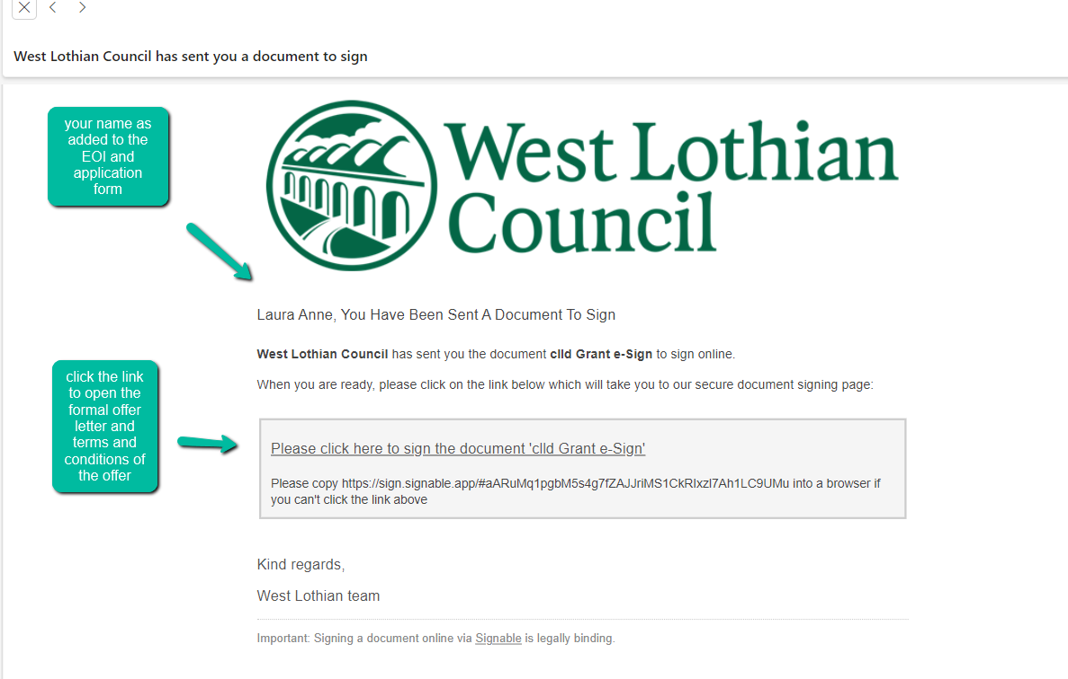
It will look like this

Slide 6
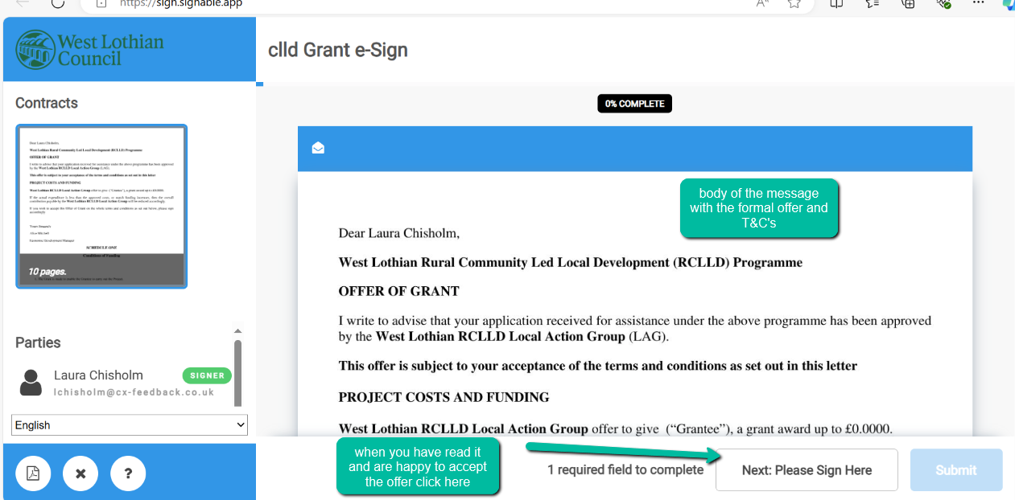
Clicking the link will open the formal letter

Slide 7
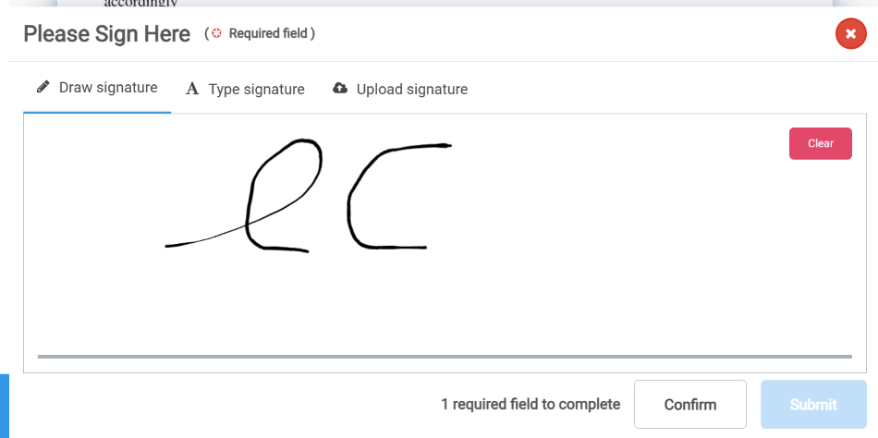
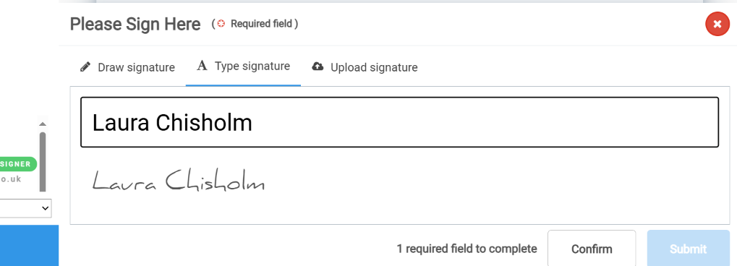
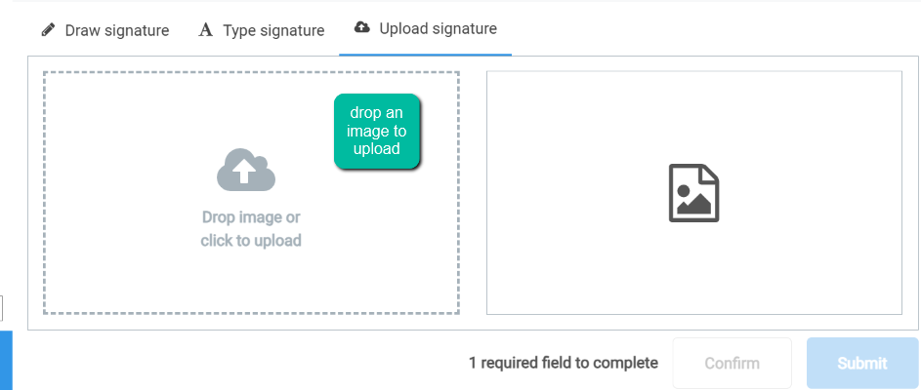
Clicking the box will allow you to
Sign by using your mouse (or finger on a phone)
Upload a pre-made signature image
Insert a typed signature from your keyboard

Slide 8
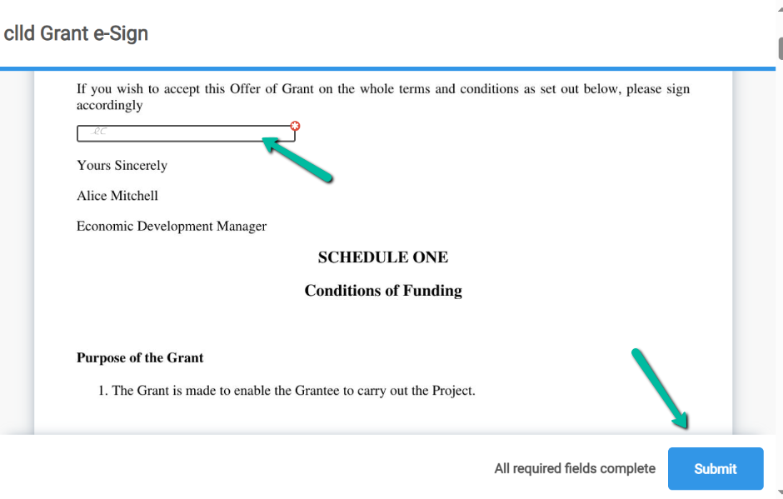
Once you have decided on the method of signing, press the Confirm button
Your signature will be inserted into the box, then submit

Slide 9
You will get a confirmation email with a PDF of your signed document for your records
You will then get another email with how to make your claim.
This email should be kept safe, but your coordinator will be able to resend if required
It contains a link for you to upload any documents, receipts etc etc that are required to support your claim against your grant offer
It is possible to make multiple claims
You will have been asked to breakdown your expenditure into cost headings such as Training, Materials etc etc – you will be required to upload receipts and documents into the same categories

Slide 10
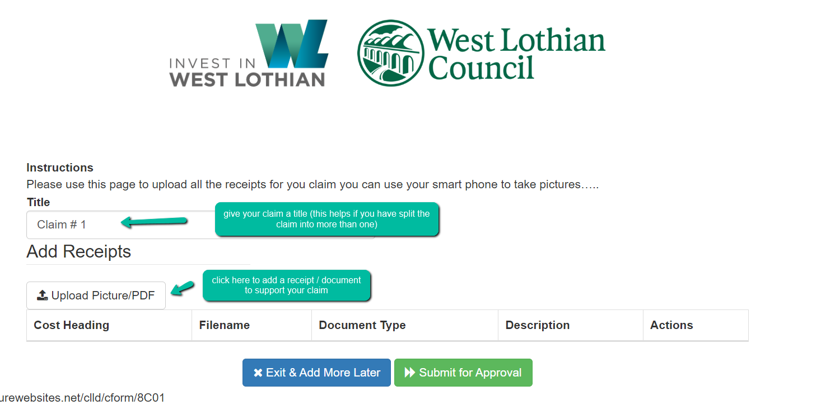
When you open the claim link it will look like this
Clicking will open this screen

Slide 11
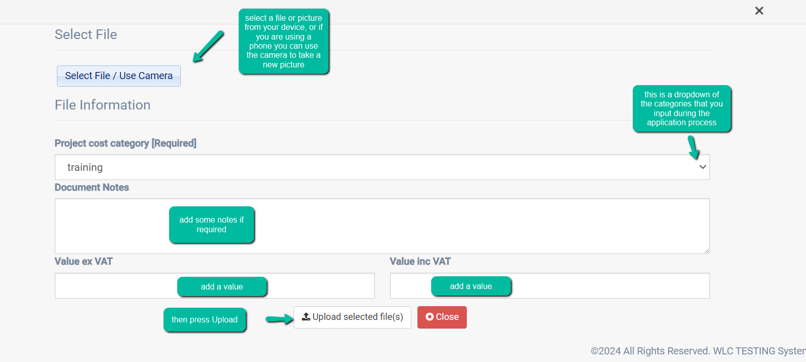
Complete the required uploads
If you are not VAT registered then you do not need to complete the value ex VAT

Slide 12
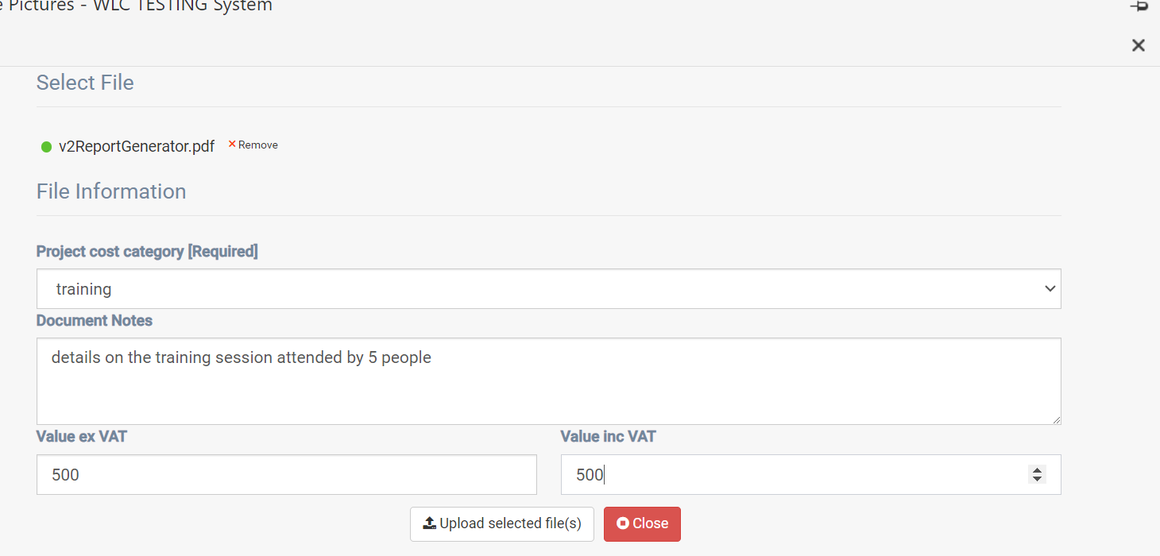
It will look like this

Slide 13
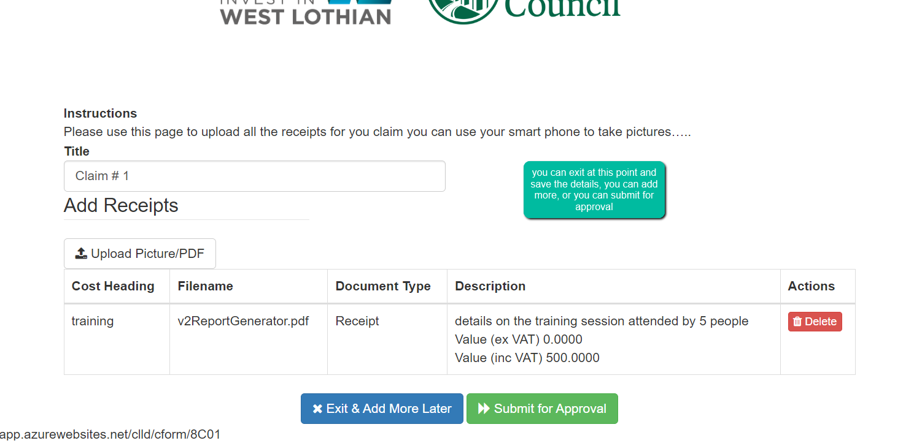
When you upload it will look like this

Slide 14
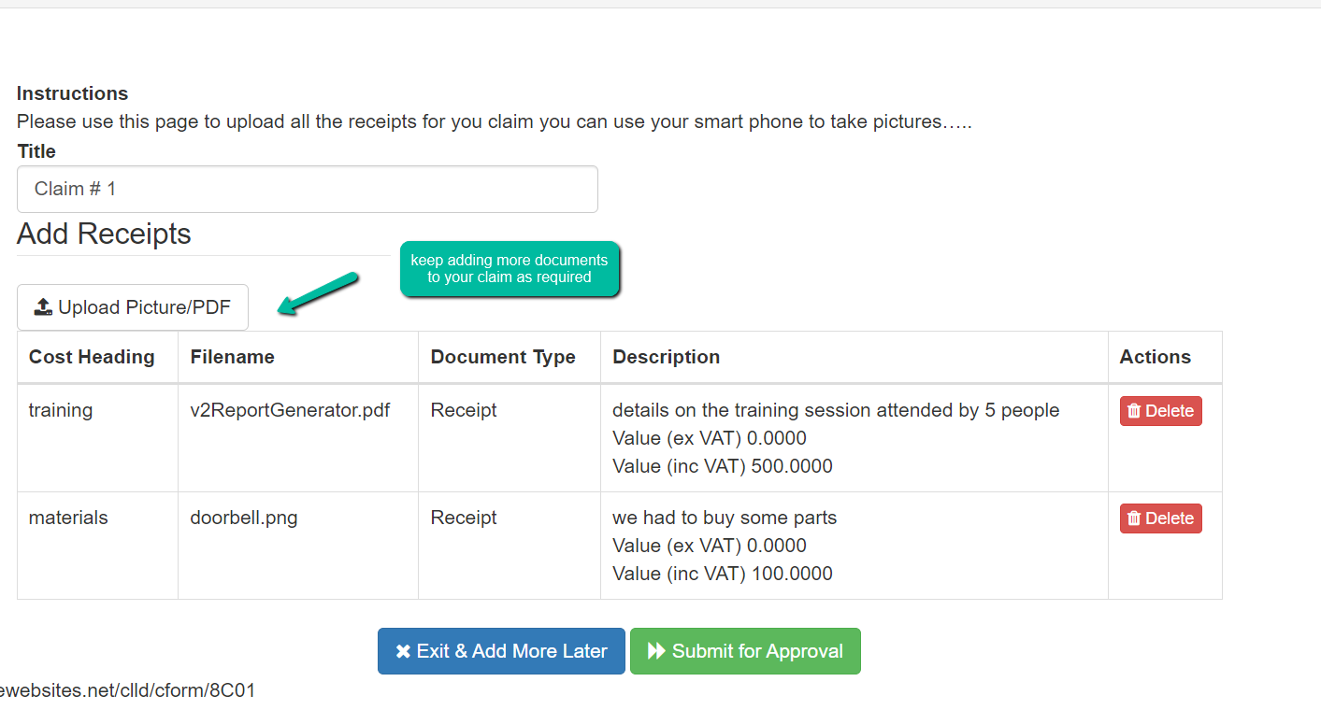
You can build up your claim before submitting

Slide 15
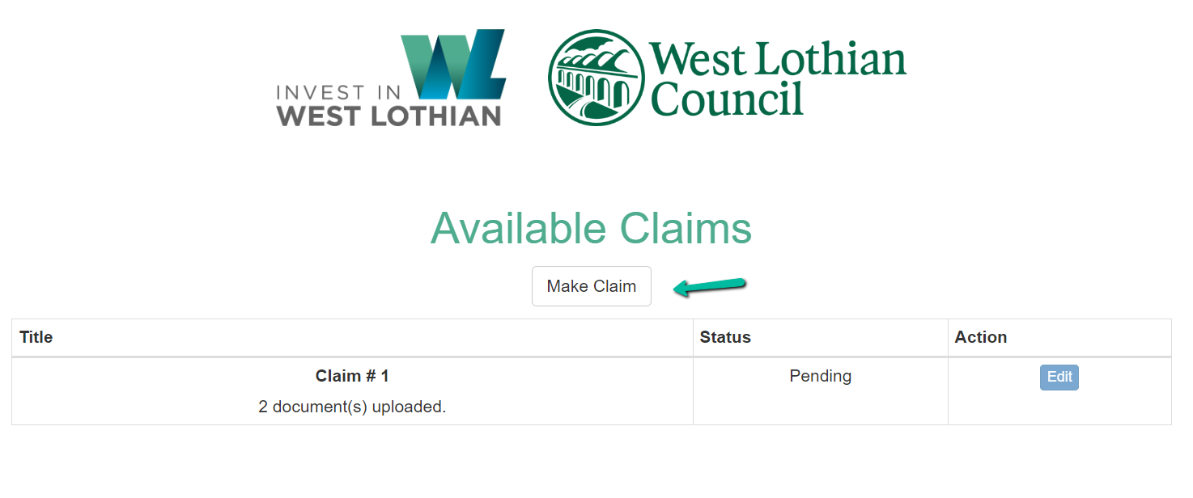
Once you have submitted a claim it can’t be changed, but it is possible that your coordinator may reject it if there is a problem.
You can simply use the SAME link to create your next claim by clicking the Make Claim button and repeating the process

Slide 16
The payment of your claim will be made directly via West Lothian Councils own systems
Once your grant is fully claimed and paid, it will be marked closed and will no longer be available for any additional claims
You will get notification of this for your records

